Slide 1




Customer Segmentation
Virtual Internship
Feni Ismiati

Slide 2




TABLE
OF CONTENTS
Business Background
2. Methodology
3. Insight & Recommendation
The data provided is a representation of the original data which amount have been adjusted.

Slide 3
Methodology
SQL
Cleaning
Data Processing
Data Collection
Google Colab
Insight
The data provided is a representation of the original data which amount have been adjusted.

Slide 4




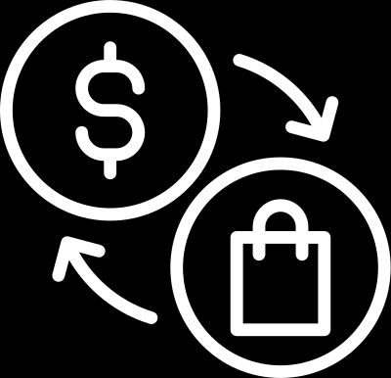
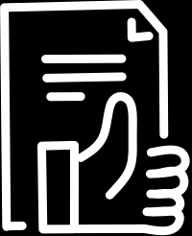
Methodology
Data Cleaning & Preparation
Data Analysis
Analyze the data using RFM analysis and
K-Means
Checking and cleaning the data (checking null and duplicates)
Exploratory Data Analysis
Define Problem
Recommendation
Define the background and objective from the data
Explore the data group according to the business requirement
Give the recommendation based on business objective
The data provided is a representation of the original data which amount have been adjusted.

Slide 5
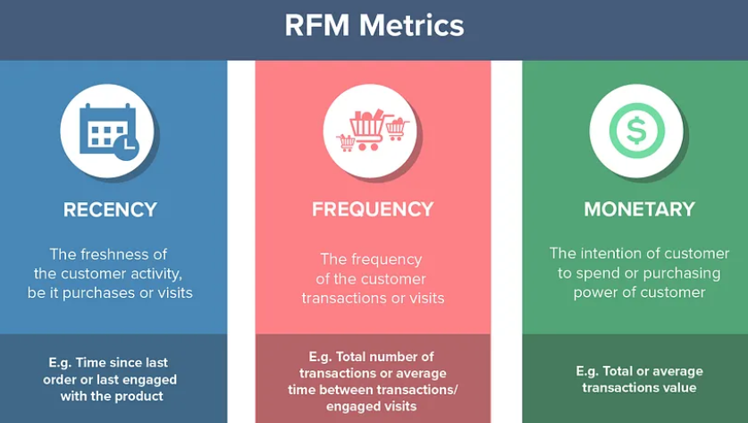
RFM Metrics
The data provided is a representation of the original data which amount have been adjusted.

Slide 6
Segment Details or RFM Ranking Method
Potential
Loyalist
New
Customer
At Risk
Customers
Potential Churn
Customers
Champions
High recency, high monetary, high frequency
High monetary, average score of frequency
Good recency and monetary, average frequency
Bad recency, average frequency, and monetary
Low RFM score
The data provided is a representation of the original data which amount have been adjusted.

Slide 7
BUSINESS PROBLEM
PROBLEM STATEMENT
Conduct different approaches in different segments using customer segmentation analysis. We would like to know the characteristics of each segment and utilize their behavior to improve business performance. On the other hand, PaDi UMKM also has the obligation to support our seller. The expert would also like to understand the characteristics of our seller. We will use this insight for better support for our seller.
The marketing budget is limited, and we want to optimize its allocation. How can we use customer segmentation to identify customer value segments and allocate our marketing resources more efficiently?
The data provided is a representation of the original data which amount have been adjusted.

Slide 8
RFM Analysis
The data provided is a representation of the original data which amount have been adjusted.

Slide 9
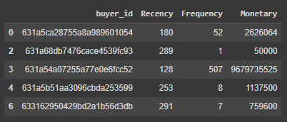
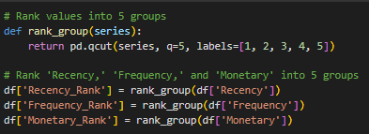
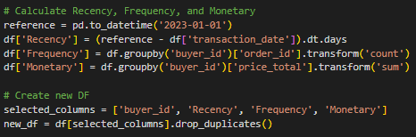
RFM Analysis
Findings
Conduct the RFM Scoring by grouping the labels into 5 groups quantile: 1, 2, 3, 4, 5
The data provided is a representation of the original data which amount have been adjusted.

Slide 10
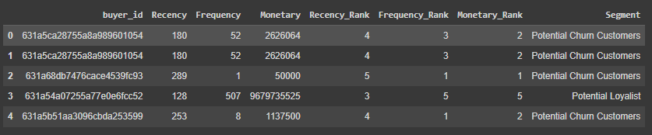
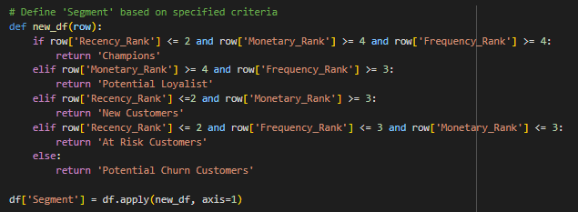
RFM Scoring
Findings
Labeling RFM rank into 5 segments, sorted by the highest rank:
Champion
Potential Loyalist
New Customers
At Risk Customers
Potential Churn Customers
The data provided is a representation of the original data which amount have been adjusted.

Slide 11
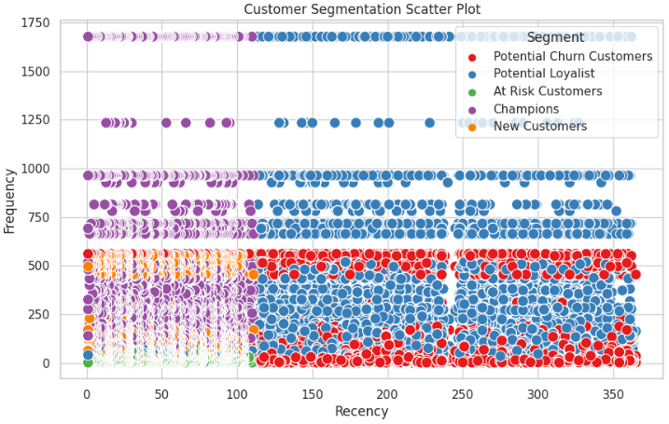
RFM Distribution
Findings
The scatter plot shows the segment distribution by comparing Recency and Frequency, found that:
Champion: High Recency, High Frequency
Potential Loyalist & Potential Churn: Mid Frequency & Recency
New Customers: High Recency, Low Frequency
At Risk Customers: High Recency, Low Frequency
The data provided is a representation of the original data which amount have been adjusted.

Slide 12
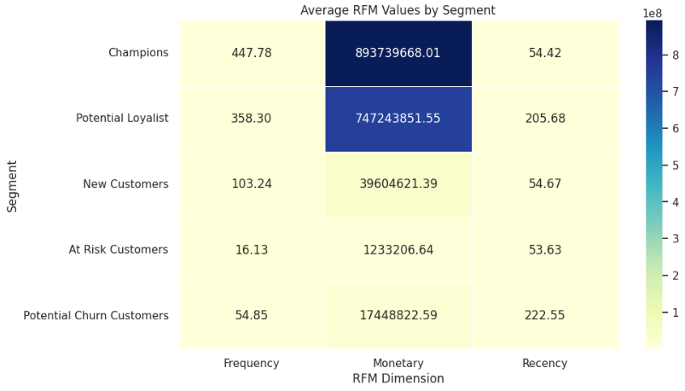
Segment by Value
Findings
Found that the highest Monetary is coming from Champion & Potential Loyalist
The data provided is a representation of the original data which amount have been adjusted.

Slide 13
K-Means
The data provided is a representation of the original data which amount have been adjusted.

Slide 14
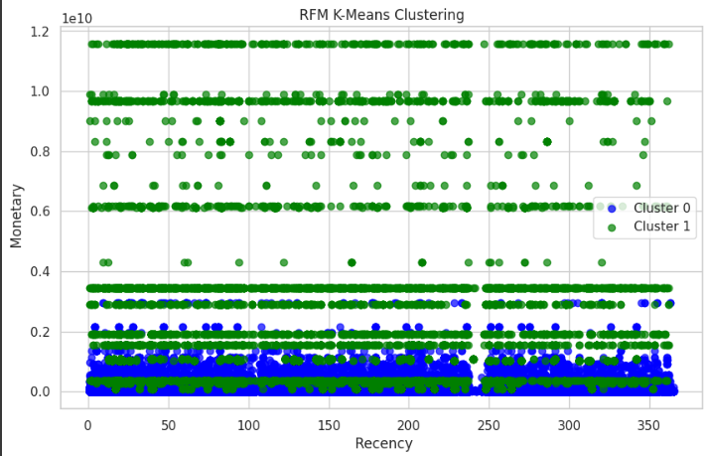
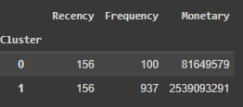
Findings
The Scatter plot shows the distribution of Monetary and Recency. Found that the Recency from each clusters are quite similar. The difference is only from Monetary, Cluster 1 has the higher Monetary compared to Cluster 0.
The data provided is a representation of the original data which amount have been adjusted.

Slide 15
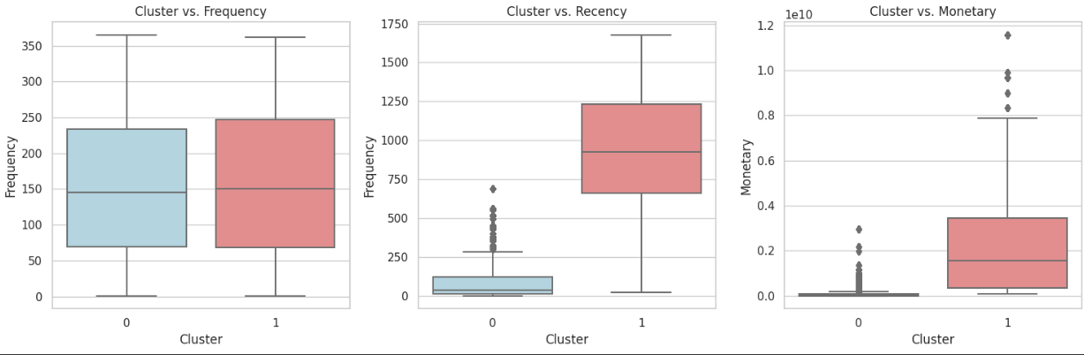
Insight & Recommendation
Recency
Insight
Found that Cluster 1 have the highest Monetary Value and Recency. Meanwhile, Cluster 0 have similar Recency, Cluster 1 and 0 have quite similar in Frequency.
The data provided is a representation of the original data which amount have been adjusted.

Slide 16
Insight & Recommendation
Cluster 1 stands out as the most lucrative segment, comprising high-spending and frequently engaged customers. Recommended strategy: Focus on upselling and introducing enticing bundled promotions.
Cluster 1 represents customers with higher spending. Strategy: Leverage discount promotions and personalized email campaigns to reignite their interest and boost engagement.
Cluster 0 represents new customers with lower spending. Strategy: Implement discount promotions to encourage repurchases and foster brand loyalty
The data provided is a representation of the original data which amount have been adjusted.

Slide 17
THANK YOU!

